Slide 1


TC 1004B – G 531

Slide 2
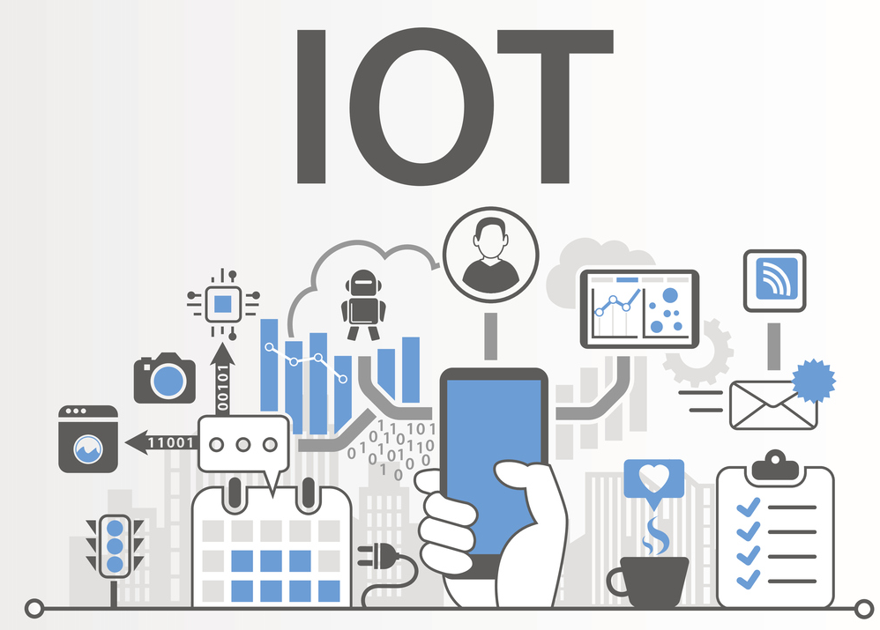
What is IoT?
… describes the network of physical objects (things) that are embedded with sensors, software, and other technologies to connect and exchange data with other devices and systems over the internet.

Slide 3

What is about this course?
For 10 weeks, students will design and implement a prototype of a digital system capable of obtaining data using sensors, processing it, and depositing it as information on an internet platform, for later analysis and visualization.

Slide 4

Learning Purposes Area Competences
SICT0200 - Data analysis of natural phenomena
SICT0201 - Pattern determination: Determine relevant patterns in a set of information using principles of natural sciences, mathematics, and computational fundamentals (B-Level).
SICT0300 – Problem-Solving in Natural and Exact Sciences
SICT0303 - Implementation of actions: Implements scientific and engineering actions or computational processes that meet the type of the solution required (B-Level).
SICT0400 - Commitment to sustainability
SICT0401 - Application of standards and norms: Applies the standards to the exercise of their profession, keeping them as a reference to follow in the solution of computational problems and information technologies (B-Level).
SICT0402 - Application of sustainability principles: Applies sustainability principles in solving computational and information technology problems that guarantee the well-being of future generations (B-Level).

Slide 5
Learning Purposes Disciplinary Competences
STC0200 (ITC) - Software Systems Development
STE0100 (IRS) - Embedded Systems
STI0300 (ITD) - Digital Strategies
STC0207 (ITC) / STE0104 (IRS) / STI0301 (ITD) - Gestión de proyectos: Gestiona proyectos de computación y tecnologías de información mediante el uso eficiente de los recursos (A-Level).

Slide 6
Learning Purposes Transversal Competences
SEG0200 - Innovative Entrepreneurship
SEG0201 - Innovation: Generates innovative and valuable solutions to environmental problems, through a cyclical process that incorporates validation and learning in positive and adverse situations (A-Level).
SEG0700 – Digital Transformation
SEG0701 - Digital culture: Uses digital technologies, through conscious strategies, that generate value in the various spaces of professional and personal participation in the networked society (A-Level).

Slide 7


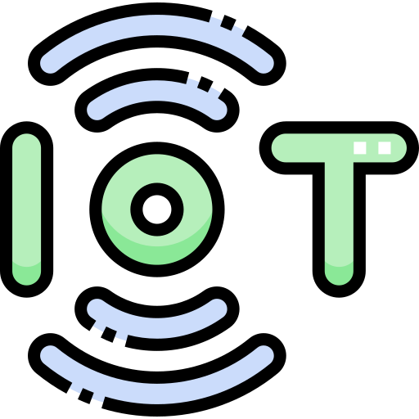
Course Organization
Section 1: Hardware
- Module 1: Digital Systems
Section 2: Software
Module 2: Database Analysis and Design
Module 3: Resource management of a computer system
Module 4: Introduction to Interactive Design
Section 3: IoT
Module 5: Project Management and Processes
Modulo 6: Internet of Things

Slide 8

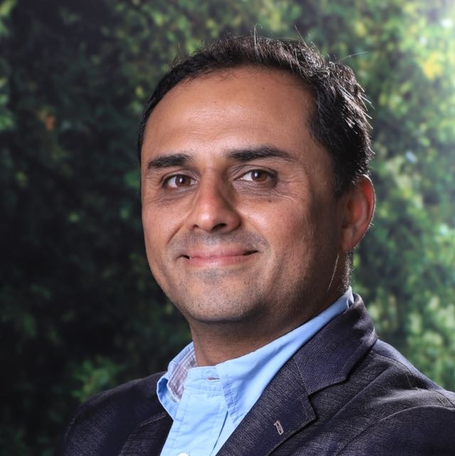
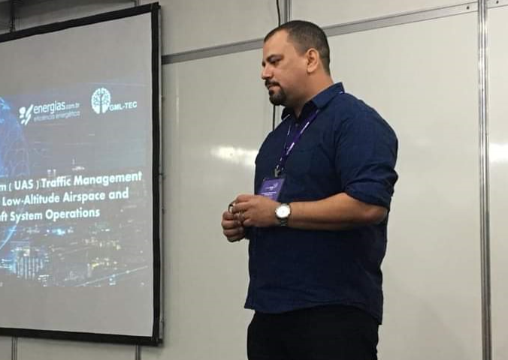
Course Organization
Prof. Luis José González
ljgonzal@tec.mx
Module 2: Database Analysis and Design
Module 4: Introduction to Interactive Design
Prof Alexandre Barreto
barretoabb@tec.mx
Module 5: Project Management and Processes
Modulo 6: Internet of Things
Prof. Luis Yépez Pérez
lyepez@tec.mx
Module 1: Digital Systems
Module 3: Resource management of a computer system

Slide 9
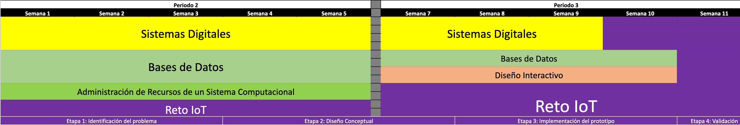
Course Methodology

Slide 10
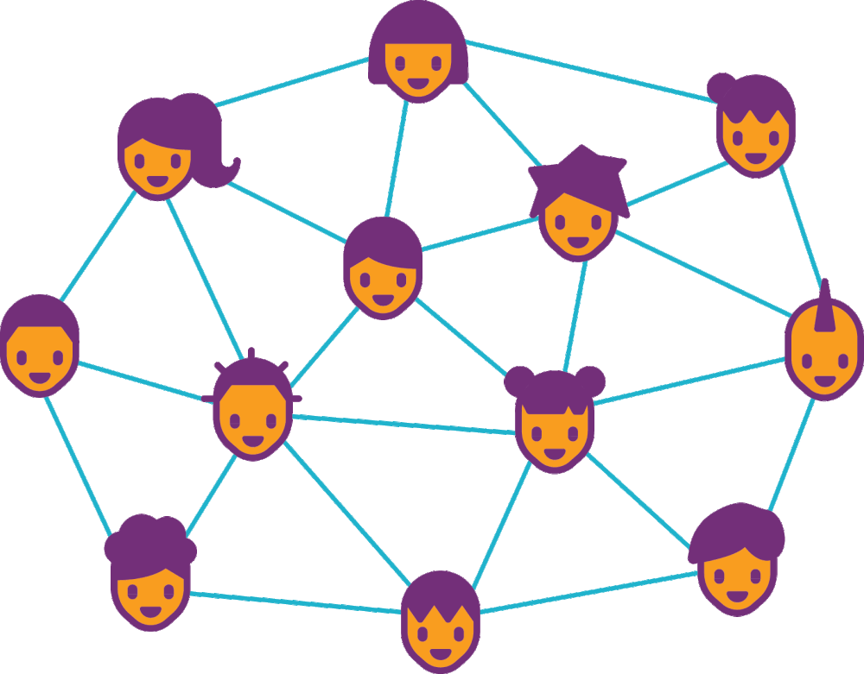



Slide 11
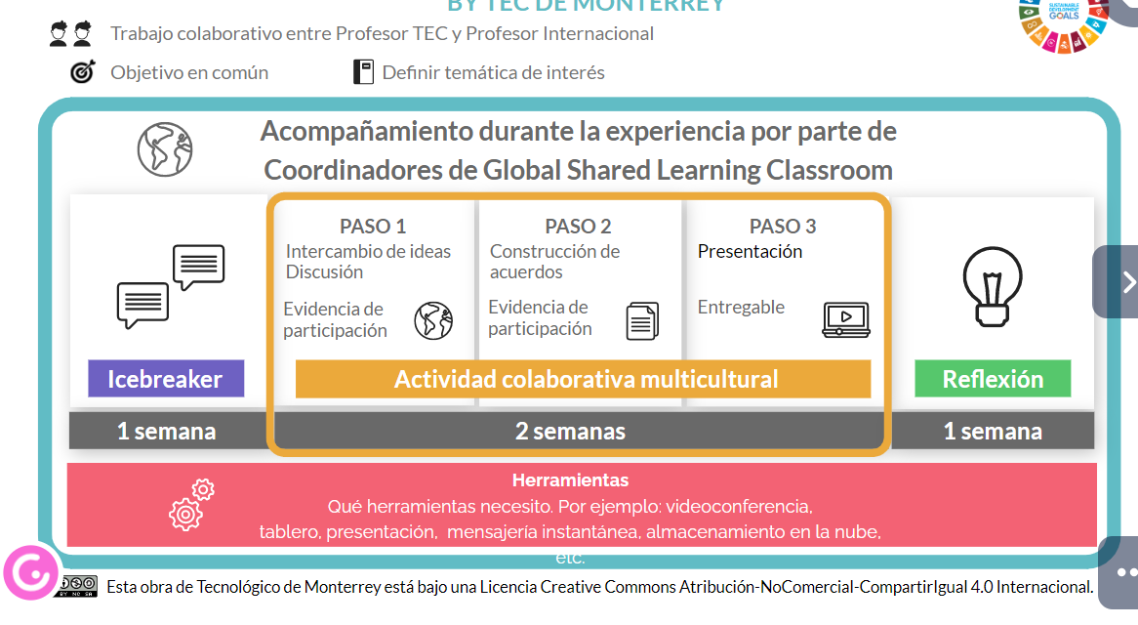

Slide 12
Evaluation Plan
Learning Activities (45 points)
Module 1: Digital Systems – 15 points
Module 2: Database Analysis and Design – 14 points
Module 3: Resource management of a computer system – 4 points
Module 4: Introduction to Interactive Design – 4 points
Module 5: Project Management and Processes – 0 points *
Modulo 6: Internet of Things – 8 points

Slide 13
Evaluation Plan
Evidence of domain levels of sub-competencies (55 points)
Argumentative Exams (Module 1 – 4): 30 points
Oral Exam (Reto - GSL): 25 points

Slide 14
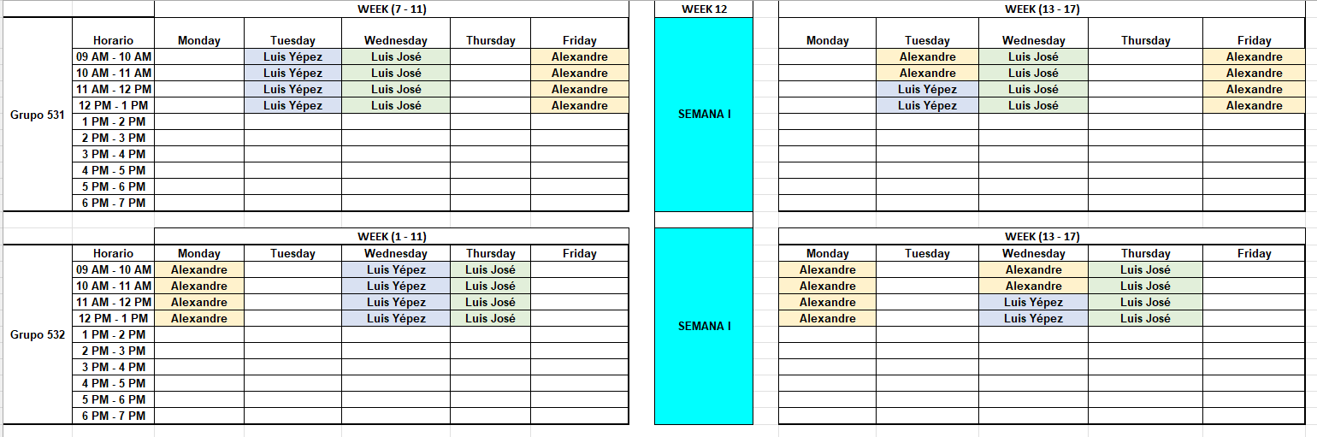
Course Schedule (531)
Reto + GSL

Slide 15
Course Schedule (532)
Reto + GSL

Slide 16
Unit 0 – Course Presentation

